Slide 1


REACT ES6 - variables
React is much easier to learn if you know ES6.

Slide 2
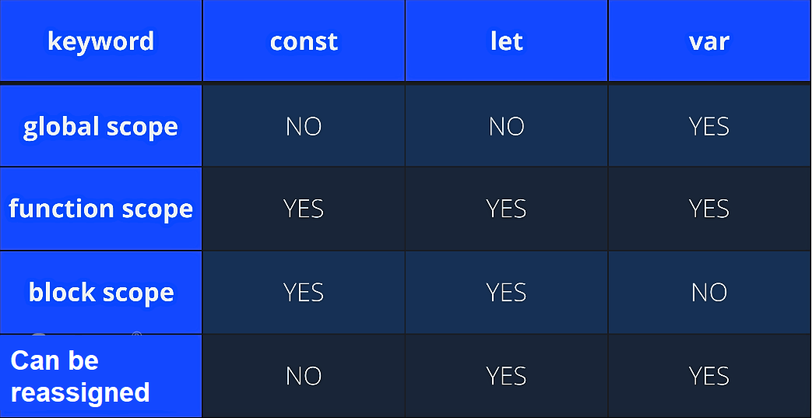
Variables
Before ES6 Only one way of defining your variables:
with the var keyword. Now, with ES6, there are three ways of defining your variables: var, let, and const.
VAR var has a function scope, not a block scope.
LET let is the block scoped version of var and is limited to the block where it is defined.
CONST const is a variable that once it has been created, its value can never change. const has a block scope.

Slide 3
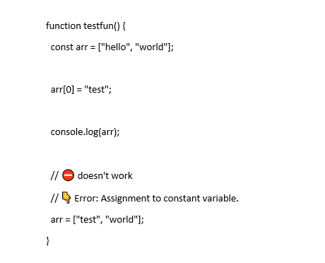
Misleading of const
The keyword const is a bit misleading.
It does not define a constant value. It defines a constant reference to a value.
Because of this you can NOT:
Reassign a constant value
Reassign a constant array
Reassign a constant object
But you CAN:
Change the elements of constant array
Change the properties of constant object.
Object.freeze:
A frozen object can no longer be changed

